Slide 1
Employee Compensation
Pub 4012, Tab D
Pub 17
(Federal 1040-Line 7)
(NJ 1040-Line 14)
Notes:
1

Slide 2
NJ Treatment of Disability Income
Key determinant for treatment of 1099-R disability income on NJ return is person’s age
Disability income on NJ return taxable if age is 65 or over (treated as a regular pension)
Disability income on NJ return not taxable if age less than 65
Notes:
For Federal purposes, determinant for treatment of disability income is company’s minimum retirement age
For State purposes, treatment is determined by recipient’s age

Slide 3
NJ Withholdings (Unemployment, Disability, Family Leave)
NJ taxes withheld from income for unemployment, disability and family leave insurance
Deductible on Federal Schedule A Line 5 unless a private plan (rather than state plan)
UI/WF/SWF(State Unemployment Insurance)
Choose NJ UI/HC/WD – NJ Unemployment Insurance from W-2 Box 14 drop-down menu in TaxSlayer (combine together if listed separately)
UI - Unemployment Insurance
WF – Workforce Fund
SWF – Supplemental Workforce Fund
Maximum contribution amount can change each year
DI(State Disability Insurance)
Choose NJ SDI - NJ Disability Insurance from W-2 Box 14 drop-down menu in TaxSlayer
Maximum contribution amount can change each year
FLI(Family Leave Insurance)
Choose NJFLI from W-2 Box 14 drop-down menu in TaxSlayer
Maximum contribution amount can change each year
Notes:
W-2 may have NJFLI, NJUI, NJDI all in box 14 or elsewhere on W-2
Must always enter it in TaxSlayer in box 14

Slide 4
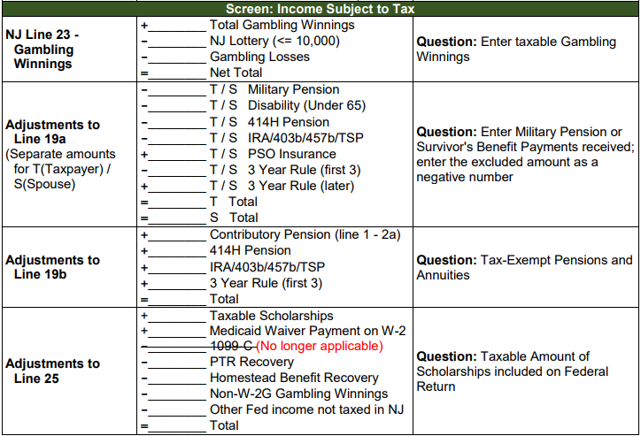
NJ Treatment of Scholarships & Fellowships
Taxable unless they satisfy all the following conditions
Primary purpose of grant is to further recipient’s education or training AND
Grant is not payment for past, present, or future services or payment for services which are subject to supervision of grantor
E.g. – fellowship for teaching) AND
Grant is not for the benefit of grantor
Capture NJ taxable scholarship amount in NJ Checklist Income Subject to Tax section for later entry in TaxSlayer State section
Notes:
4

Slide 5
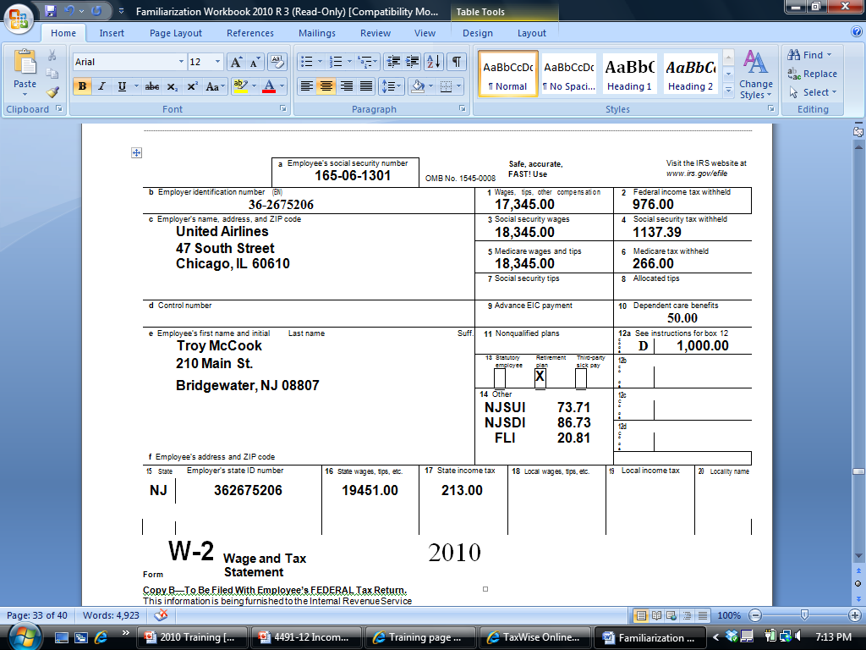
Sample W-2
Federal wages different than SS/Medicare wages
123-06-1301
Dependent care
Douglas Davis
210 Main Street
Bridgewater, NJ 08807
DD
6,350.00
NJSUI 82.67
NJSDI 73.91
NJFLI 19.45
401k Contribution
Box 12 Code DD - Amount for Employer-Provided Health Insurance; not taxable
NJ Wages different than Federal wages
Notes:
This is the source document a working client will present for their wages
A W-2 can be multiple pages
Some interesting things on this W-2:
Federal wages are different than Social Security & Medicare wages
Employee received Dependent Care benefits from employer in Box 10
Employee made a contribution to a 401k plan, indicated by code in Box 12. Notice that amount contributed to 401k pre-tax is difference between Federal wages & Social Security/Medicare wages
NJ box 16 state wages are different than Federal box 1. There is an amount that is pre-tax federal but after- tax NJ. Need to see pay stub to determine what it is. Important if it is medical
Box 12 code DD – shows amount for employer-provided health insurance
Not taxable
Just enter into TaxSlayer Box 12
5

Slide 6
TS – Wages and Salaries Federal Section \ Income \ Enter Myself \ Wages and Salaries (W-2)
(cont'd)
Enter
TaxSlayer populates; update as
needed
TaxSlayer does not recalculate Boxes 3-6
based on 401K contribution
Choose from drop-down menu
Notes:
Enter Employer ID & Employer Name & Address (if they don’t come up automatically from entering employer ID - EIN)
Enter Zip Code, & TaxSlayer will populate city & state
Enter Wages in Box 1
TaxSlayer will automatically populate SS & Medicare wages/tax withheld in Boxes 3, 4, 5, 6
When Federal wages not = SS or Medicare wages, it is often because of a pre-tax 401k contribution, which is shown in Box 12 as a code D. TaxSlayer will not automatically change the SS or Medicare wages if you enter code D in Box 12
If you need to changed Box 3 or 5 wages, you must manually correct them. A change in Box 3 will cause TaxSlayer to re-calculate Box 4; a change in Box 5 will cause TaxSlayer to re-calculate Box 6
Enter any other #s from W-2 Boxes 2, 7-12
TaxSlayer will include Allocated Tips from Box 8 in Wages (1040 Line 7)
TaxSlayer will use Dependent Care Benefits from Box 10 in calculating Credit for Child & Dependent Care Expenses on Form 2441 Part III Line 14
Enter NJSUI (Unemployment), NJSDI (Disability), & NJFLI (Family Medical Leave) amounts in TaxSlayer Box 14 (even if they are someplace else on W-2)
On some W-2s, WF or SWF (Work Force Development – a portion of Unemployment NJSUI) is separated from Unemployment. When entering in TaxSlayer, add WF/SWF & Unemployment together & enter in box 14 under NJSUI
TaxSlayer will include the amounts entered in Box 14 in State/Local Taxes you paid on Sch A Itemized Deductions
Private plans, indicated by PP#, cannot be claimed on Sch A. Therefore, must choose “Other” from drop-down menu in Box 14 so that amount does not flow through to Sch A. Entries under “Other” will also not flow through to NJ Form 2450 for excess contributions to unemployment, disability, or family leave
If other entries in this box, such as 414h, choose “Other” for Box 14. They do not flow through to Sch A
If more items are in box 14 of the W-2 than there is room for on the TaxSlayer W-2, combine them together and enter on the open line
6

Slide 7
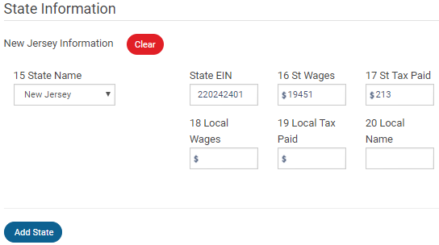
TS – Wages and Salaries Federal Section \ Income \ Enter Myself \ Wages and Salaries (W-2)
(cont'd)
TaxSlayer transfers from Box 1; update if needed
Choose from drop-down
menu
Add another state if needed
Notes:
Enter State ID #
TaxSlayer automatically enters State Wages in Box 16 (based on Federal wages)
If State Wages on W-2 is different than TaxSlayer populated, must manually change the state wages
Enter State Tax Withheld from Box 17
7

Slide 8
Wages and Salaries - TS Tips
Enter all data fields from W-2
TaxSlayer data must exactly match W-2 form
Except for Box 14 NJ special taxes; choose from drop-down menu instead of using W-2 labels
Enter verification code (if in Box 9) to combat identity theft/fraud
Remember to check taxpayer or spouse box
Verify taxpayer address on W-2
TaxSlayer pre-populates address with info entered in Basic Information section. If address on W-2 is different, make appropriate changes to match W-2
TaxSlayer will populate employer name and address based on EIN entered (if in database)
Verify this info against the W-2 since it frequently changes; makes necessary changes
Notes:
8

Slide 9
Wages and Salaries - TS Tips
(cont'd)
Box 14 – Can deduct amounts paid for unemployment, disability, and family leave insurance as itemized deductions on Schedule A Line 5a State and Local Taxes. Must choose appropriate labels from drop-down menu so amounts flow through to Line 5a correctly
Use NJ UI/HC/WD – NJ Unemployment Insurance
NJ SDI – NJ Disability Insurance
NJ FLI (for family leave insurance)
If any of above are a Private Plan (indicated by PP #), rather than the state plan, it cannot be claimed on Schedule A. Use the following process to correct Line 5a:
Enter Box 14 items as usual. Unemployment, disability and family leave amounts will flow through to Schedule A Line 5a
Notes:
9

Slide 10
Wages and Salaries - TS Tips
(cont'd)
Adjust Line 5a amounts. Go to Federal Section \ Deductions \ Enter Myself \ Itemized \ Taxes You Paid. Enter the private plan amount as a negative number on the Additional State and Local Income Tax line
If other entries on W-2 (e.g. - 414H), enter in Box 14 and choose Other from drop-down menu
Can only have 4 lines in Box 14, so may need to add together
Choose New Jersey from drop-down menu in Box 15
TaxSlayer automatically populates State Wages in Box 16 with Wages amount from Box 1
Update State Wages as necessary to match W-2
If W-2 shows wages from another state, click Add State button to add that data
Notes:
10

Slide 11
Excess NJSUI, NJSDI or NJFLI
(cont'd)
NJSUI, NJSDI, and NJFLI have maximum amounts of withholding per year
Maximums may change every year
Each employer is responsible for not withholding more than the maximum amounts
If any given employer withholds too much, employee must resolve with employer
If taxpayer or spouse has multiple employers, combined withholdings may exceed maximums
NJ allows taxpayer to claim a credit for the excess withheld on NJ 1040 by completing Form NJ 2540
TaxSlayer automatically transfers amounts from W-2 Box 14 to Form 2450 if multiple employers. Also calculates amounts withheld that are greater than maximums
For Private Plans, you normally should manually enter PP # on Form 2450. No way to do this currently in TaxSlayer
Credits will appear on NJ 1040 Lines 52 – 54 as appropriate
Notes:
11

Slide 12
TS - Excess NJSUI, NJSDI, NJFLI: NJ Form 2450
TaxSlayer transfers from W-2 Box 14
if multiple employers
Currently no way to manually add PP # to Form 2450
Totals withheld
Maximum withholdings
Excess disability withheld

Slide 13
TS - Excess NJSUI, NJSDI, NJFLI: NJ 1040 Lines 52 - 54
Notes:
TaxSlayer automatically transfers the excess withholdings from NJ 2450 to NJ 1040 Lines 52 - 54

Slide 14
Federal Pre-Tax Medical Insurance Expenses
Pre-tax medical insurance through employer
Taxpayer pays premiums with before-tax money, reducing taxable wages
W-2 Box 1 shows Federal Wages after pre-tax health insurance premiums are subtracted
Taxpayer receives tax benefit of reduced wages, so can’t itemize as medical expense on Schedule A
NJ does not consider these premiums pre-tax, so W-2 Box 16 shows gross State Wages
Difference between Federal and State Wages on W-2 a clue that Taxpayer paid pre-tax premiums. Probe with client
May be able to claim premiums as medical expense on NJ 1040 Line 30

Slide 15
Federal Pre-Tax Medical Insurance Expenses
(cont’d)
Obtain pre-tax medical expenses from taxpayer’s last pay stub for year
Identify which pre-tax deductions are medical. Can be other things too
These pre-tax benefits are often called Cafeteria or Section 125 plans
These plans allow employee to choose personalized mix of benefits (medical, dental, vision, legal services, day care, etc.) under Section 125 of the tax laws

Slide 16
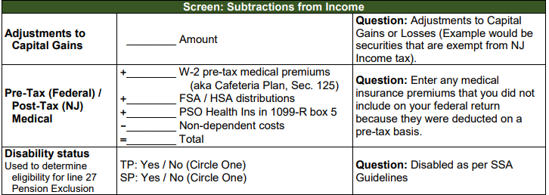
Federal Pre-Tax Medical Insurance Expenses
(cont’d)
Note pre-tax medical amount in NJ Checklist Subtractions from Income section for later entry in the TaxSlayer State section as after-tax medical expenses

Slide 17
Medicaid Waiver Payments
Medicaid waiver payments are paid to a caregiver for providing nonmedical support services to an individual in the caregiver’s home
These payments can be excluded from income
If taxpayer receives a tax document for these payments, need to enter into TaxSlayer in a way that excludes the income in the correct way so that gross income, EIC and income for credits are all calculated correctly
See Pub 4012 Page D-62 for details
Notes:
Paid

Slide 18
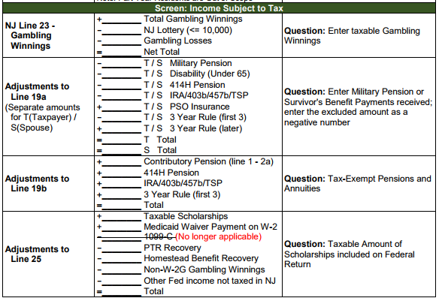
Medicaid Waiver Payments
If entries need to be made on 1040 Line 21 Other Income to record these payments correctly, may need to capture this information in NJ Checklist Income Subject to Tax section for later entry in TaxSlayer State section
Notes:
Paid

